Slide 1

RRT Motion Planning for Franka Emika 7 DoF Robot Arm
By Subhadeep Chatterjee, Nikola Raicevic, Huaijing Hong

Slide 2
RRT Planning
Efficiently explores high-dimensional spaces for path planning.
Grows tree incrementally from the start position towards random samples in the space.
Prioritizes exploration over optimization, producing feasible but suboptimal paths.
Works well in environments with complex obstacles.
Paths may appear jagged and inefficient.
Often requires post-processing to smooth the path.
Fast but may struggle to find paths in narrow passages.
 | Running Time(s) | Hit Obstacle | Reach Goal
Env1 | 4.5 | 0/3 | 3/3
Env2 | 32 | 1/3 | 2/3
Env3 | 50 | 2/2 | 0/2

Slide 3
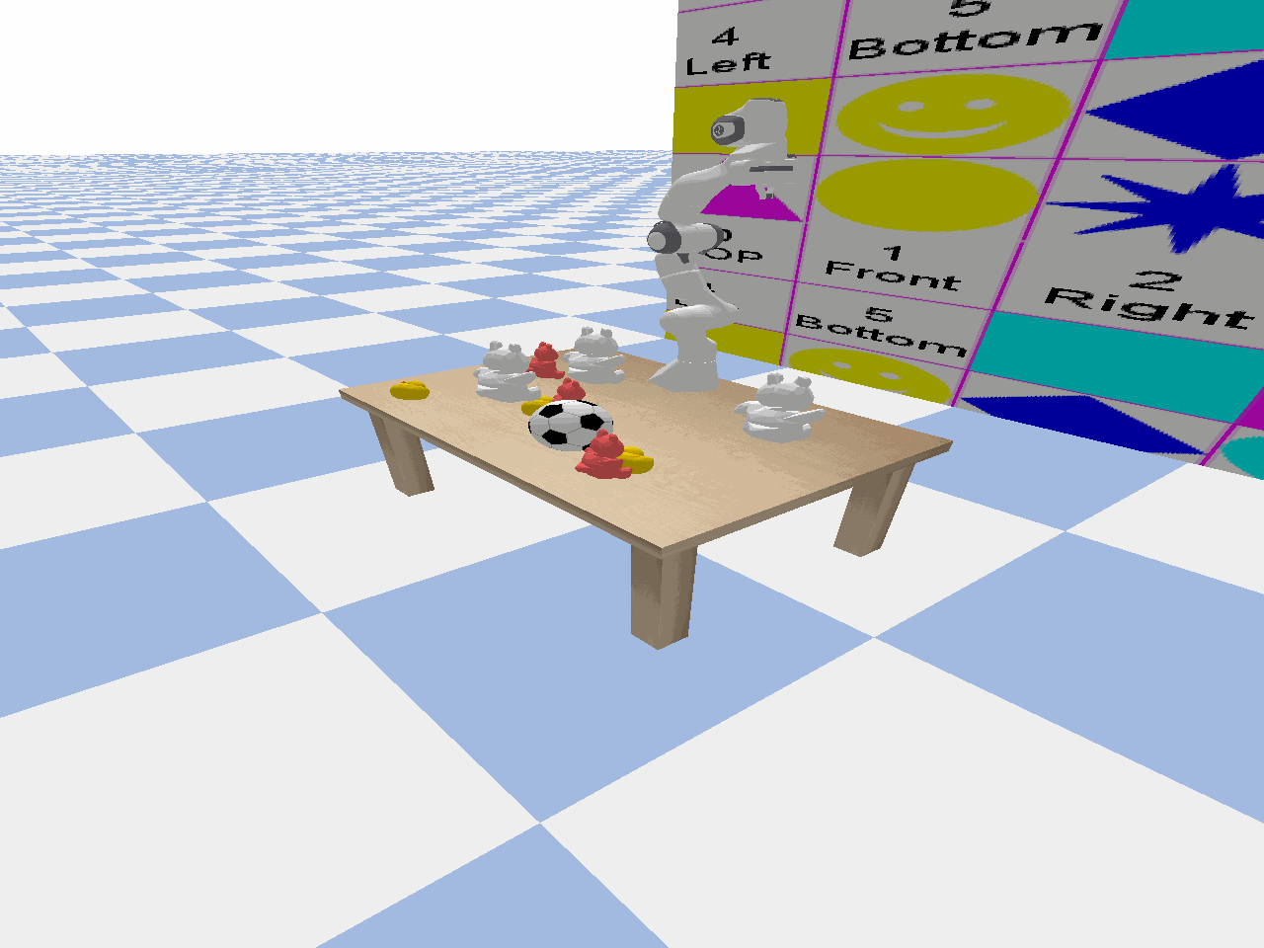
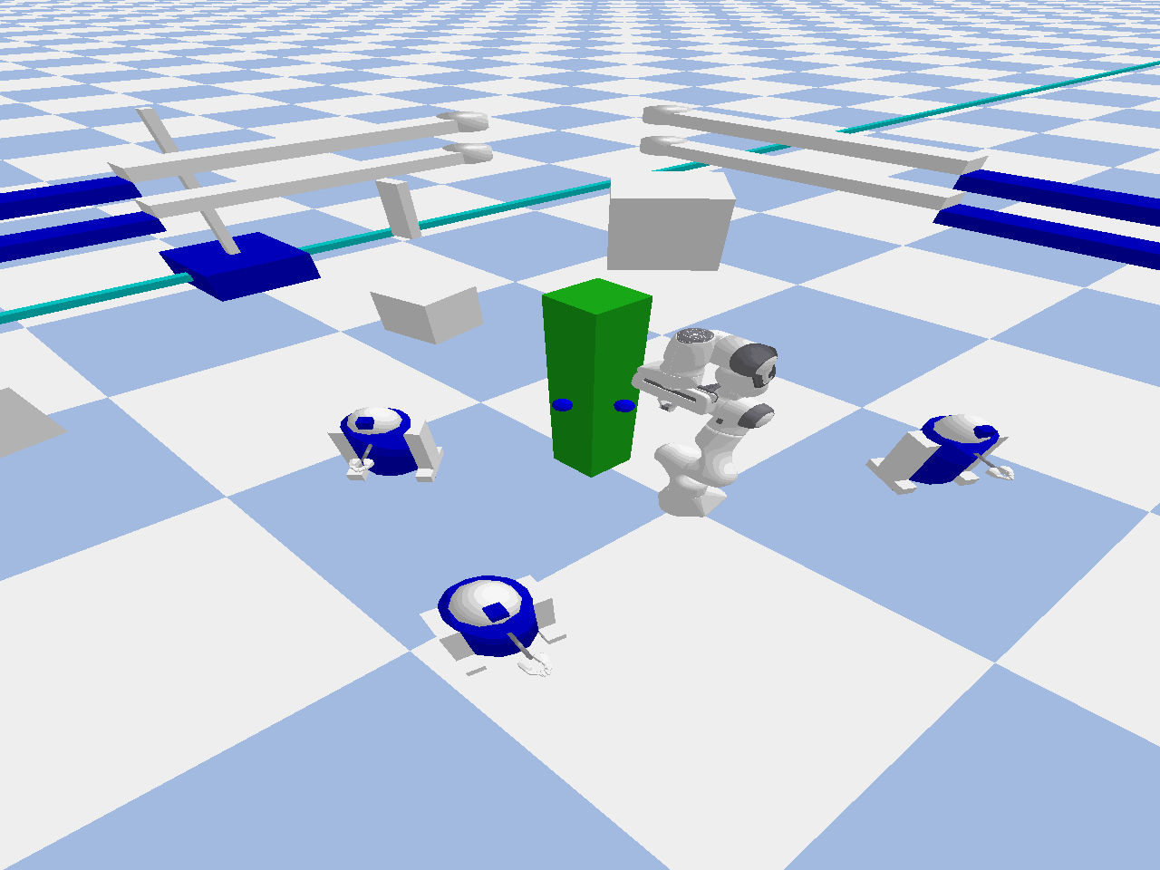
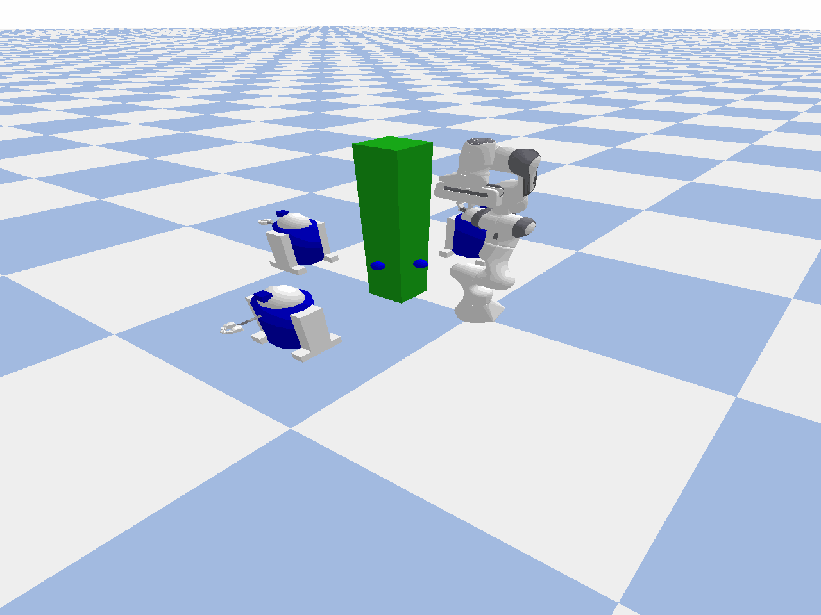
Unsuccessful

Slide 4
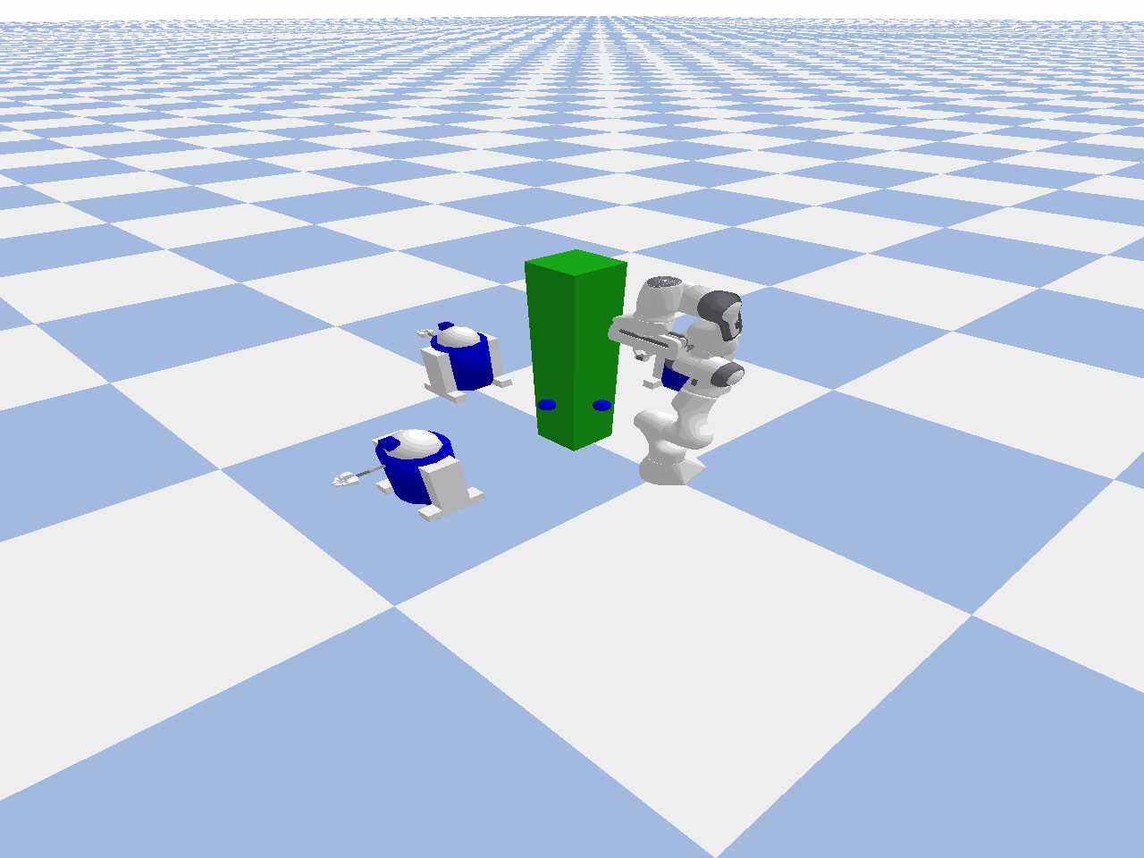
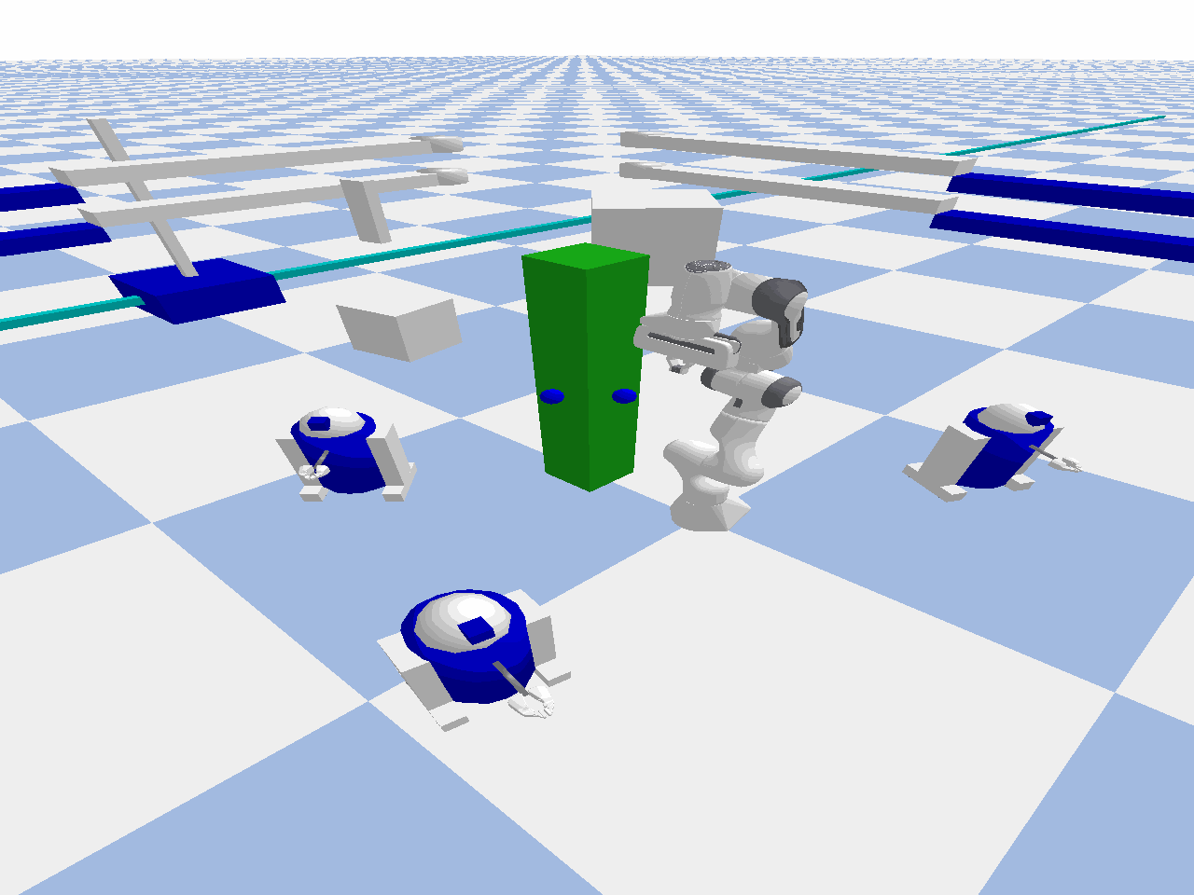
Successful

Slide 5
RRT* Planning
Builds on RRT by refining the tree to find near-optimal paths.
Introduces a "rewiring" step to minimize path cost during growth.
Guarantees asymptotic optimality as the number of iterations increases.
Slower than RRT but generates smoother, shorter paths.
Paths are significantly shorter and smoother compared to RRT.
Computationally intensive, especially in complex environments.
Requires more iterations for high-quality solutions.
 | Running Time | Hit Obstacle | Reach Goal
Env1 | 7.8 | 0/3 | 3/3
Env2 | 16 | 3/3 | 2/3
Env3 | 20 | 1/2 | 2/2

Slide 6
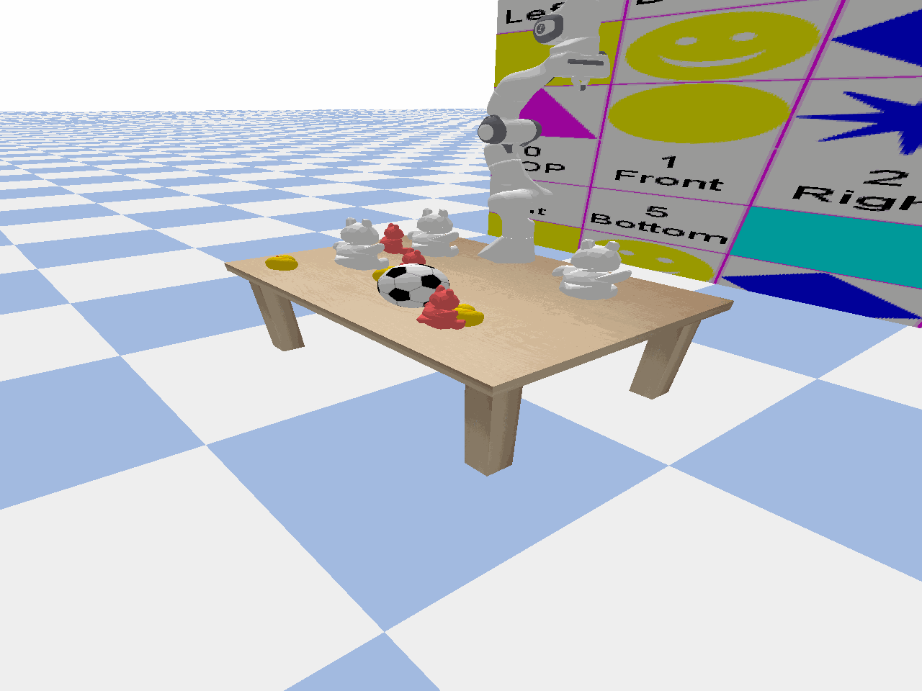
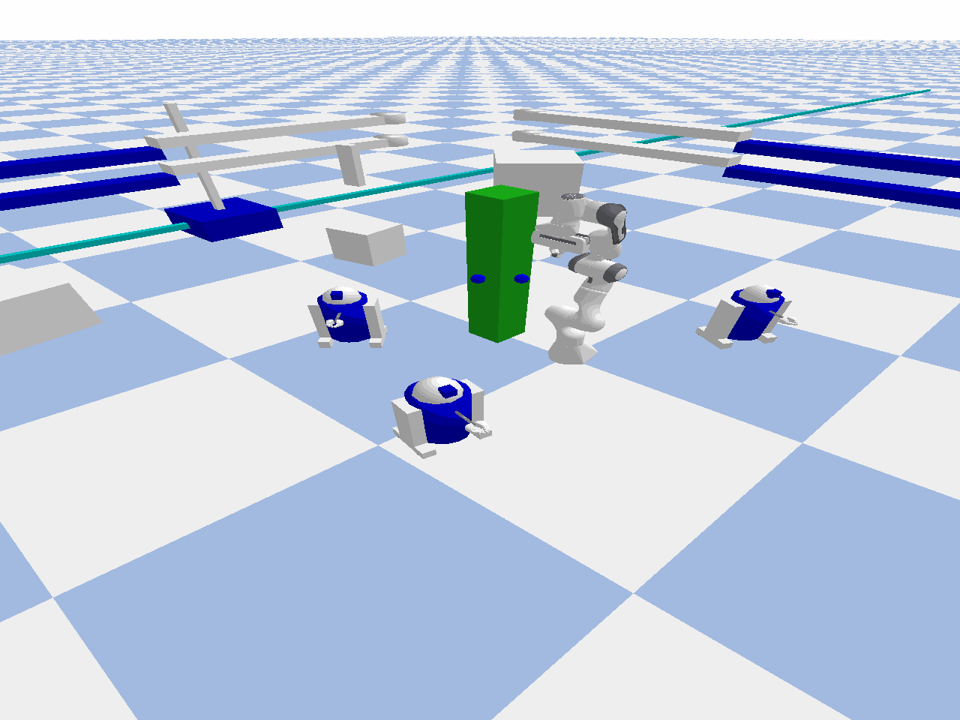
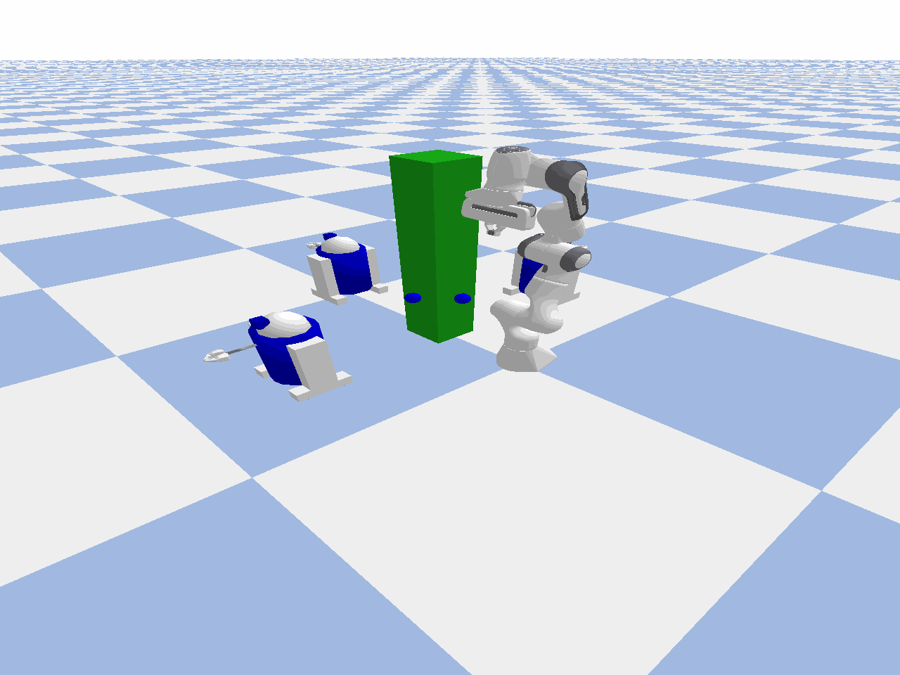
Unsuccessful

Slide 7
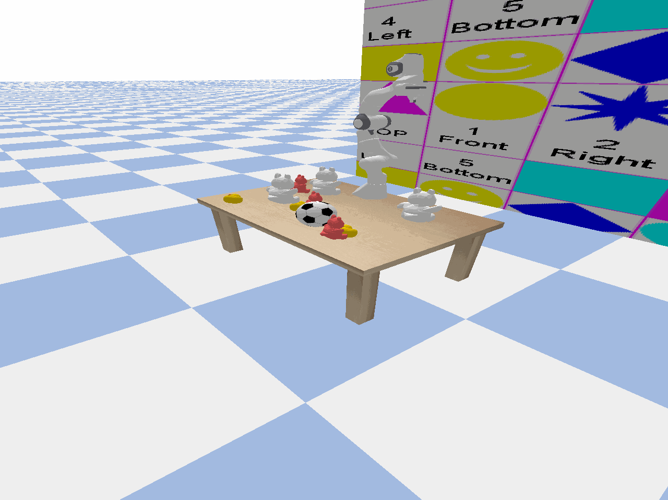
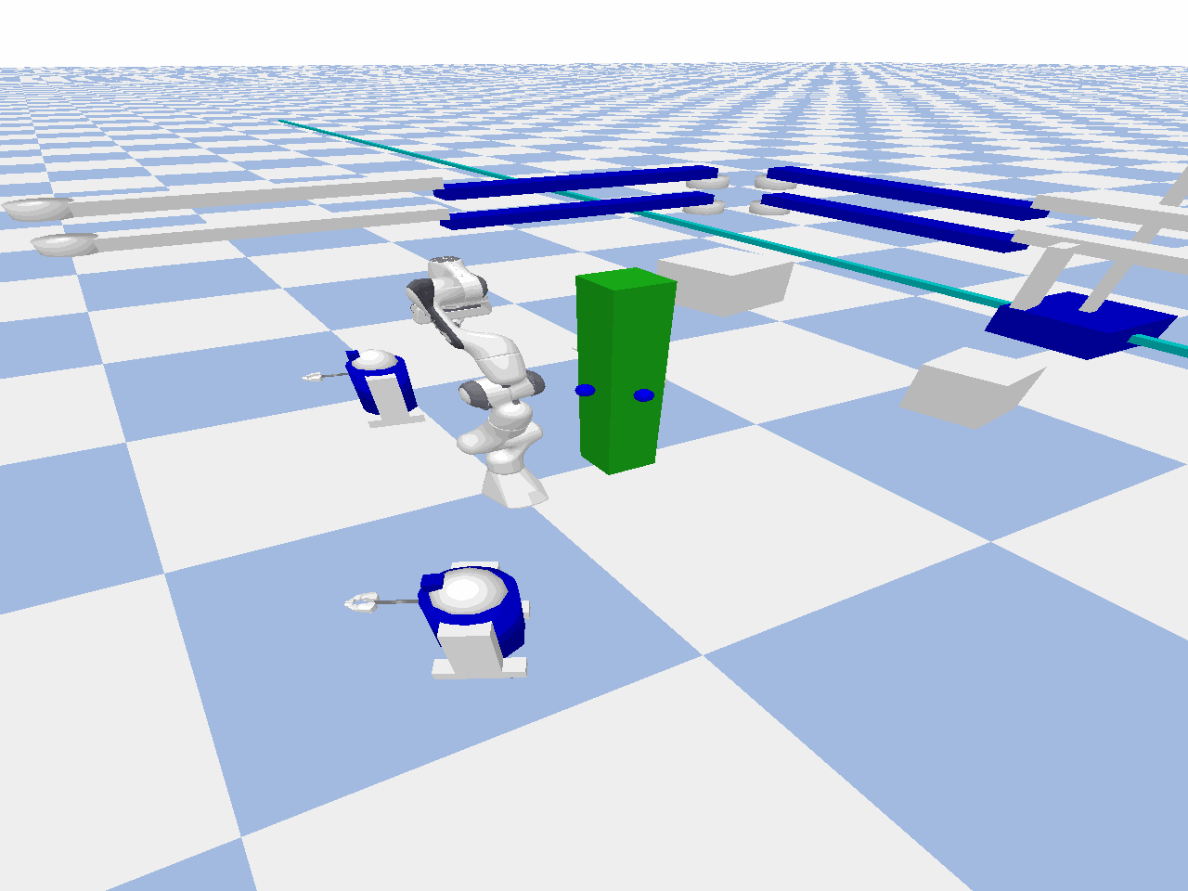
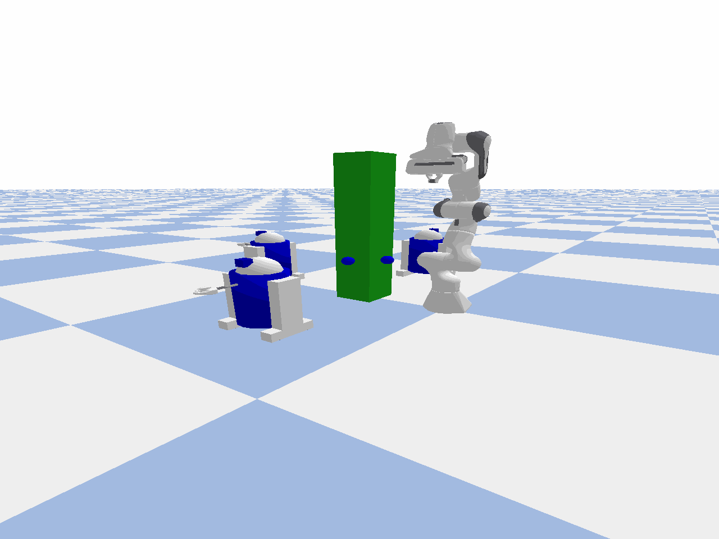
Successful

Slide 8
RRT* based Obstacle Proximity scan and avoid
Enhances RRT* by factoring obstacle proximity into path optimization.
Penalizes paths that pass too close to obstacles, improving safety.
Balances path length and safety during rewiring and expansion.
Useful in environments with dynamic obstacles or high-risk zones.
Paths maintain safety margins from obstacles.
Slightly longer paths compared to standard RRT*, trading off optimality for safety.
Effective in ensuring robust paths in cluttered or dynamic settings.
 | Running Time | Hit Obstacle | Reach Goal
Env1 | 5.5 | 0/3 | 3/3
Env2 | 27 | 1/3 | 2/3
Env3 | 18 | 1/2 | 2/2

Slide 9
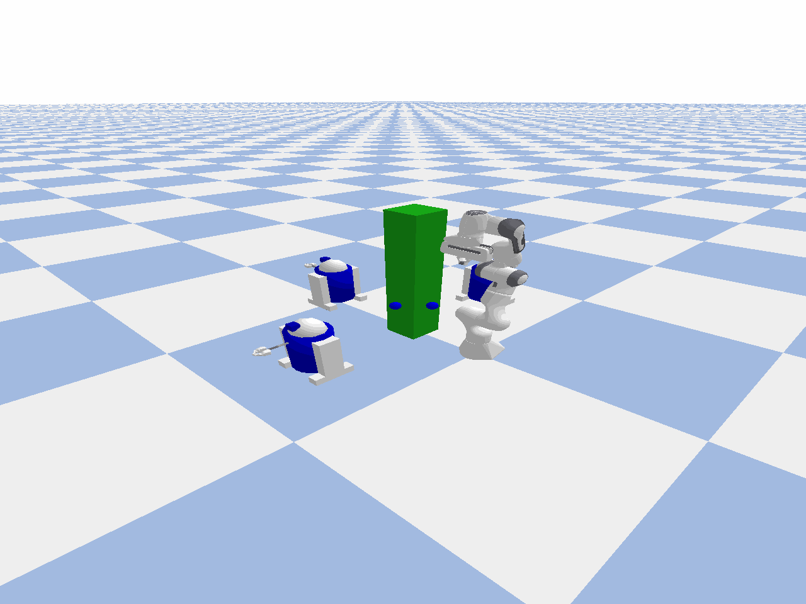
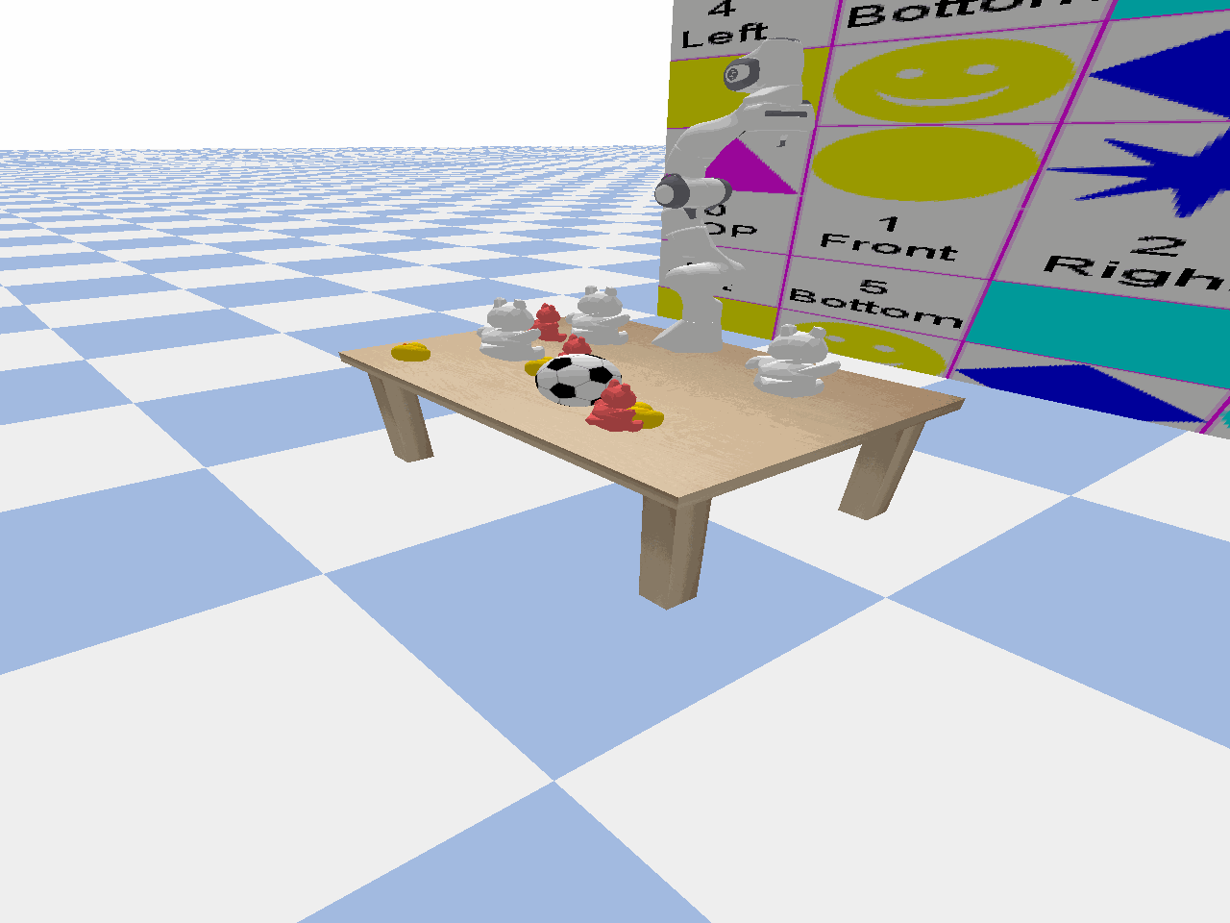
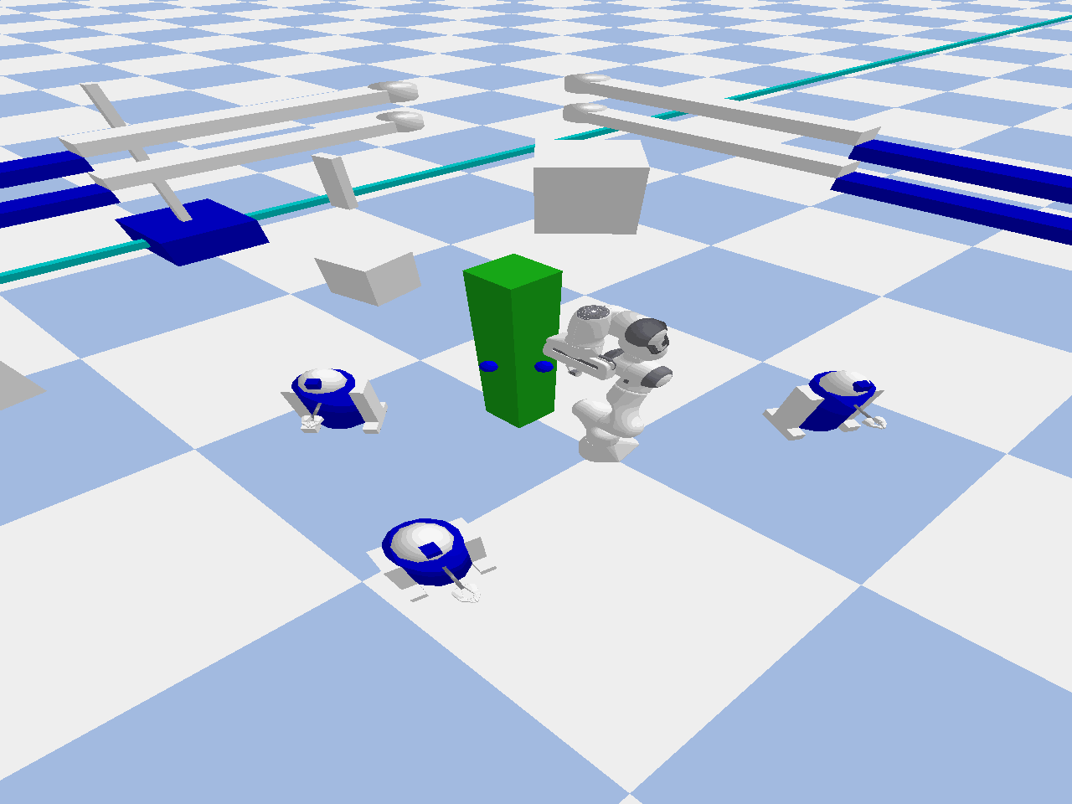
Unsuccessful

Slide 10
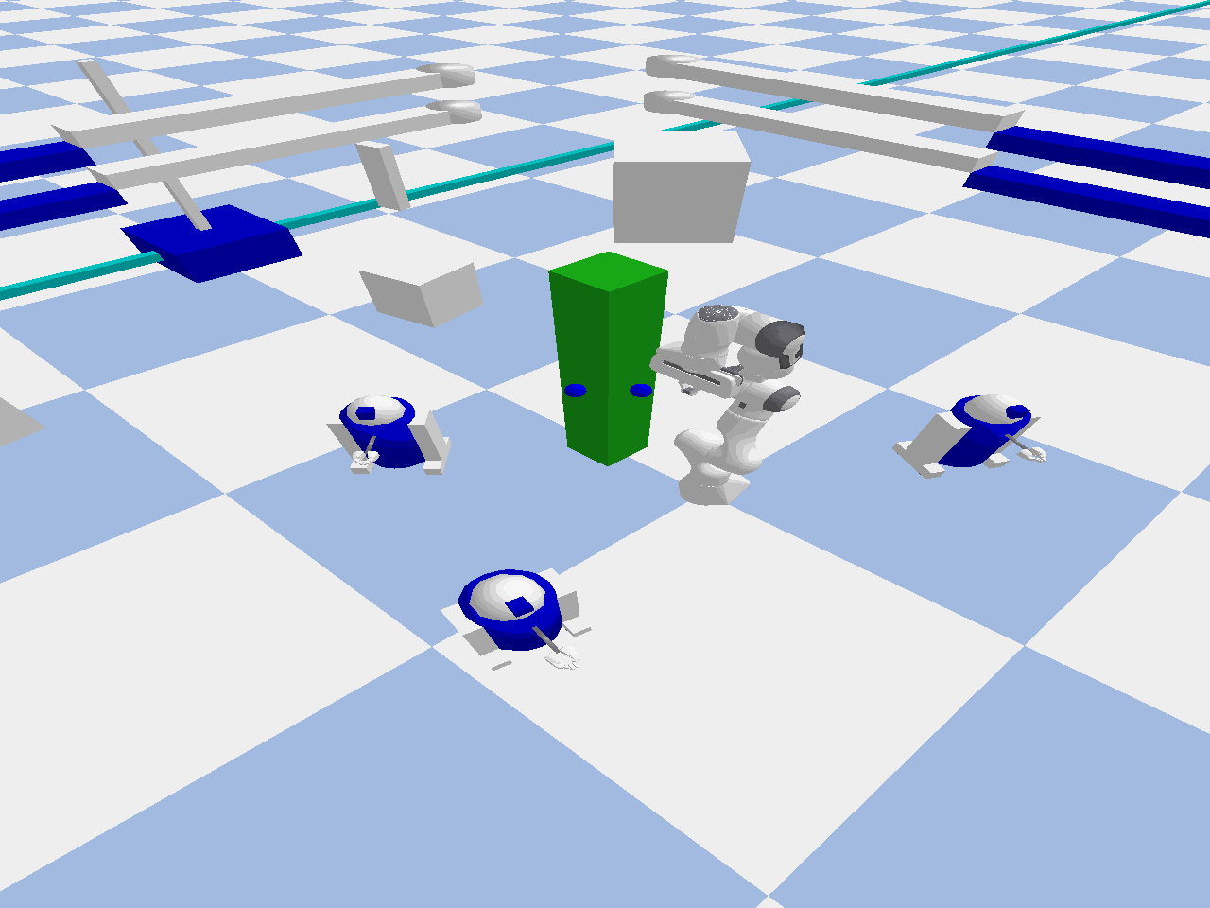
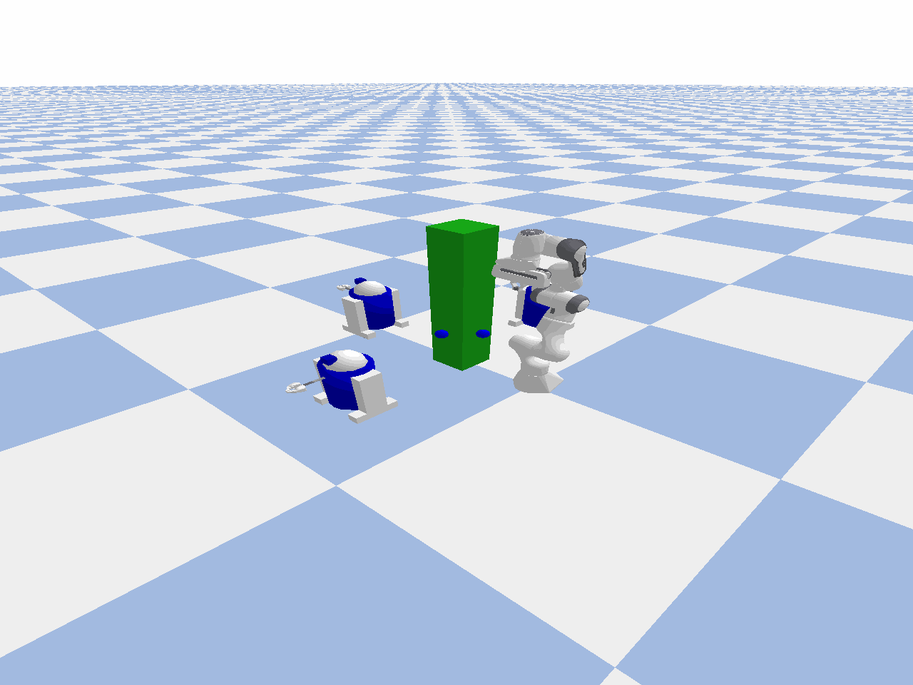
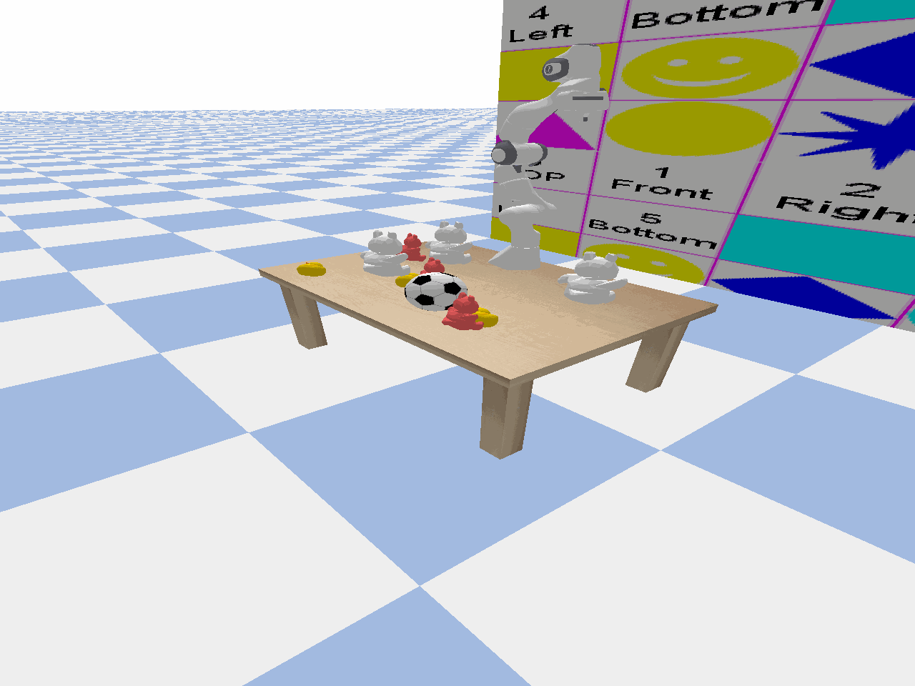
Successful

Slide 11
THANKS

